Slide 1

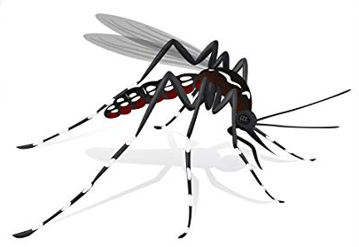
Genetically engineered resistance to Zika virus in Aedes aegypti
Adeline Williams, William Reid, Irma Sanchez-Vargas, Jingyi Li, Alexander W.E. Franz, Malcolm J. Fraser, Ken E. Olson
PhD Student, Ken Olson lab
Colorado State University
June 17, 2020
ASV Virtual Workshop
Arboviruses: Invertebrate Host/Vector-Virus Interactions

Slide 2
Presentation Outline
Introduction
Aedes aegypti innate immunity
Our transgenic approach
Results
Development of ZIKV-resistant Ae. aegypti
Phenotyping transgenic mosquitoes
Future Directions
Additional anti-pathogen transgenic strategies
Population replacement approach

Slide 3
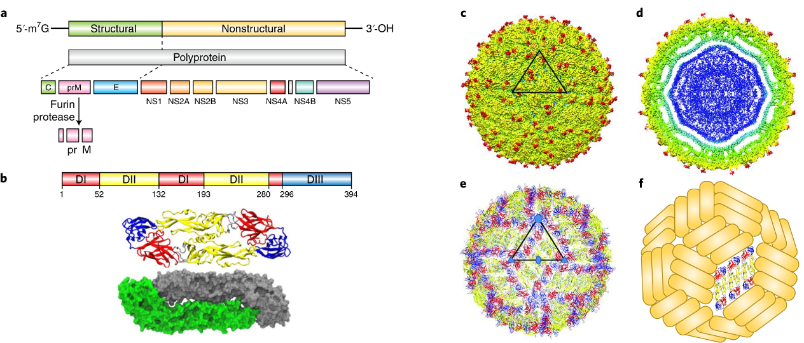
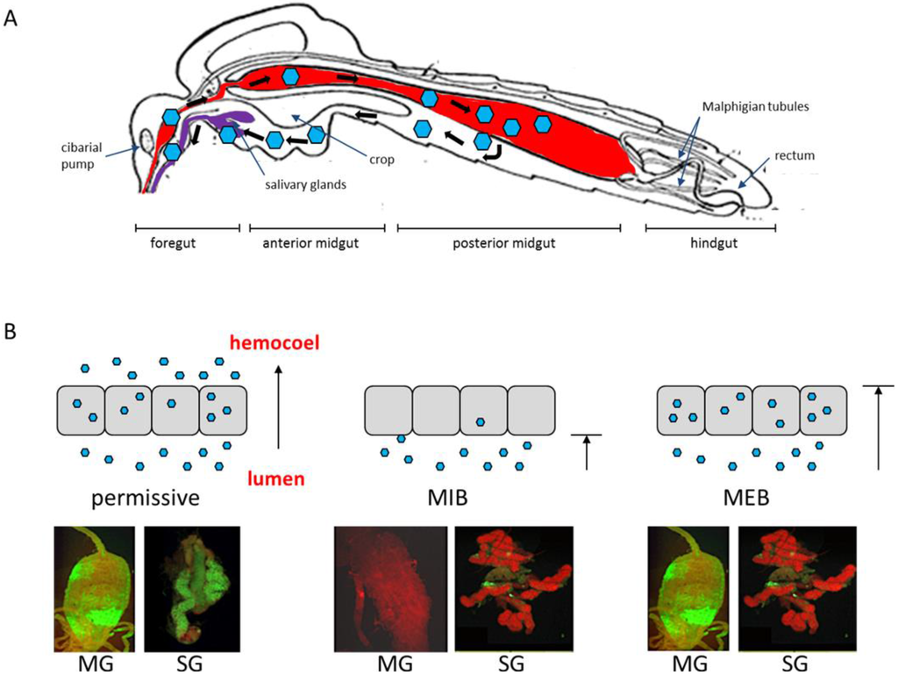
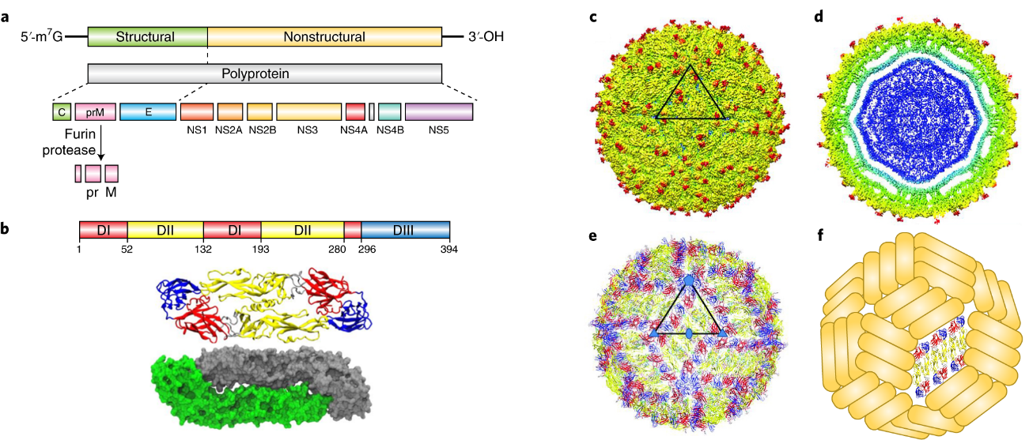
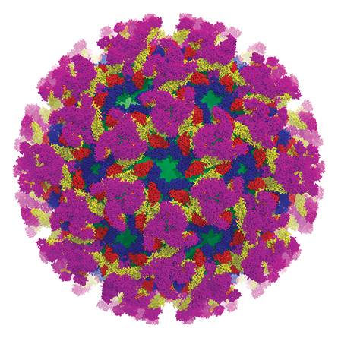
Aedes aegypti mosquitoes transmit several arboviruses
ZIKV
DENV
Competent to many viruses
Anthropophilic/urban breeding sites
Multiple bloodmeals
Lifespan > virus extrinsic incubation period
CHIKV
Virus images adapted from Campos et al., 2018 Nature Immunology
Notes:
ZIKA: microcephaly in pregnant women
DENV: fever, hemorrhagic fever, shock syndrome
CHIKV: High fever, Joint pain/swelling, rash, chronic arthritis
Competent to virus -- disseminated infection, migrate to salivary glands
Few treatment options…no good vaccines..want to target the mosquito

Slide 4
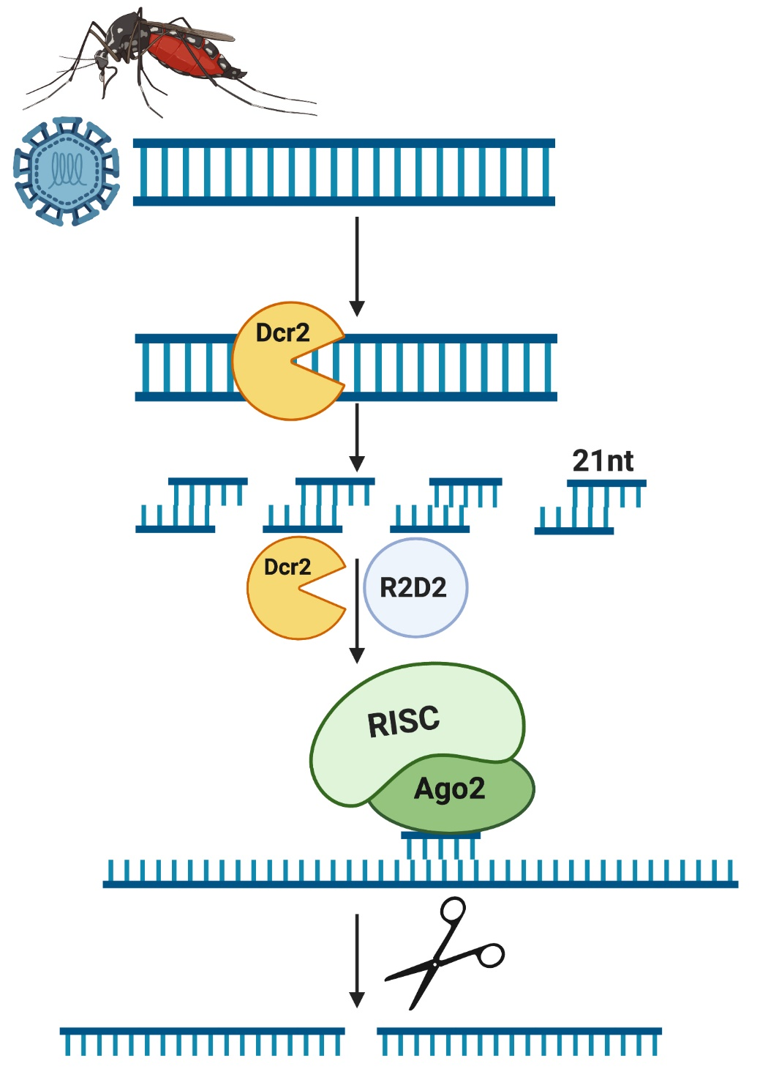
Aedes aegypti RNAi antiviral immunity: The siRNA pathway
Notes:
Mosquitoes use RNAi as an immune mechanism to control arbovirus infections.
Viral dsRNA produced during an infection of a cell are processed by the RNAse III enzyme Dicer 2 into 21 nt siRNA duplexes. These siRNAs interact with R2D2 and Dicer-2 and are loaded onto the RNA-induced silencing complex (RISC). The passenger strand is removed from the activated RISC while the guide strand directs the endonuclease Argonaute 2 to complementary RNAs in the cell, leading to sequence specific degradation

Slide 5
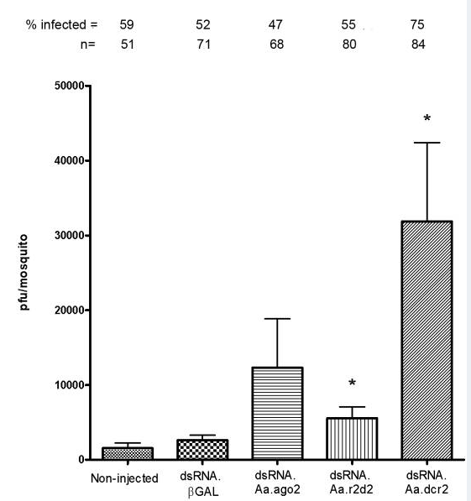
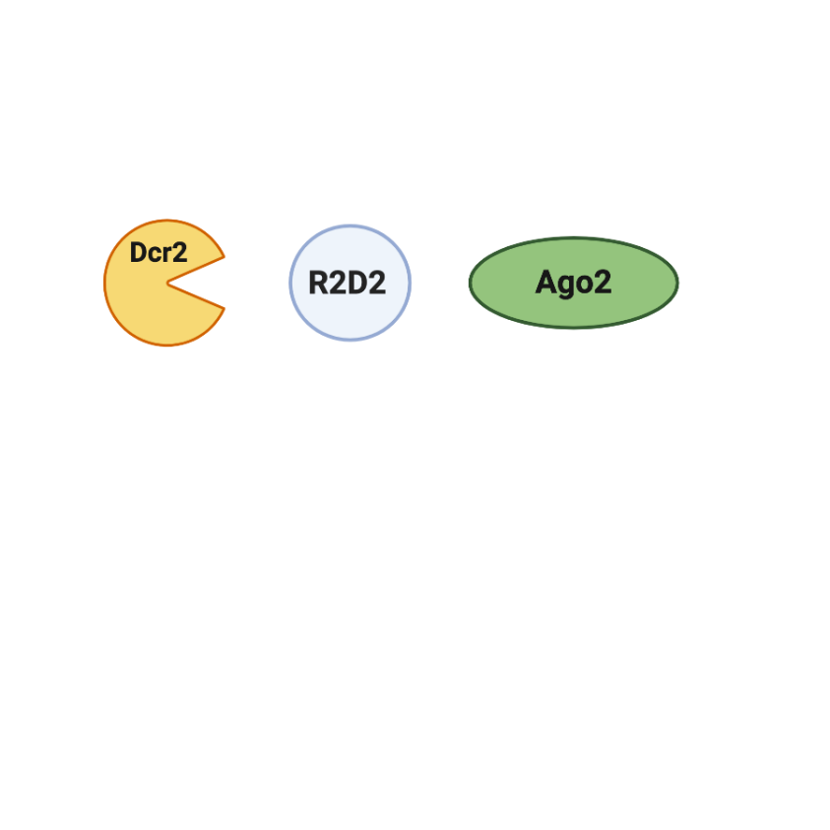


Aedes aegypti RNAi antiviral immunity: The siRNA pathway
DENV2 PFU/mosquito
Dcr2
Sanchez-Vargas et al., 2009, PLOS Pathogens
Notes:
Mosquitoes use RNAi as an immune mechanism to control arbovirus infections.
Viral dsRNA produced during an infection of a cell are processed by the RNAse III enzyme Dicer 2 into 21 nt siRNA duplexes. These siRNAs interact with R2D2 and Dicer-2 and are loaded onto the RNA-induced silencing complex (RISC). The passenger strand is removed from the activated RISC while the guide strand directs the endonuclease Argonaute 2 to complementary RNAs in the cell, leading to sequence specific degradation

Slide 6
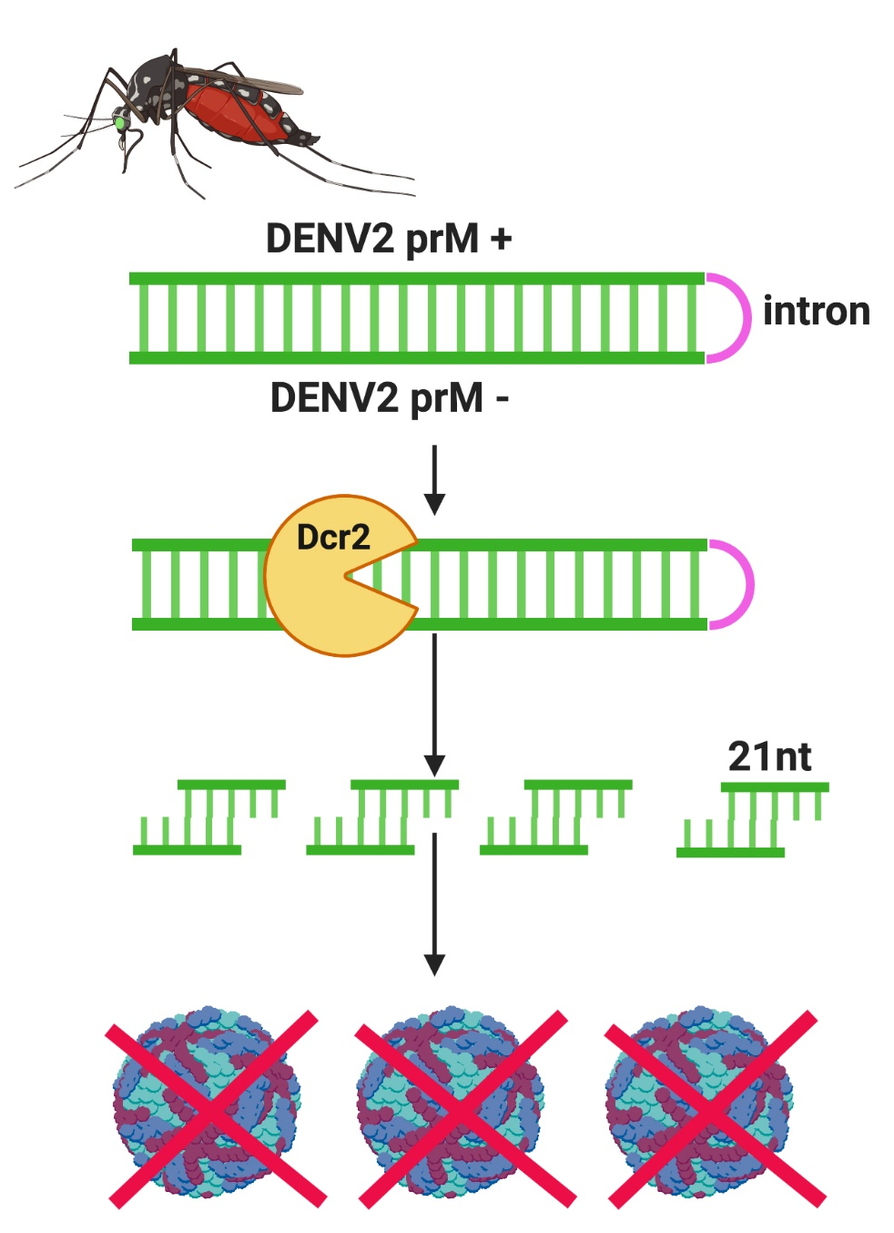
Aedes aegypti RNAi antiviral immunity: The siRNA pathway
DENV-2 resistant transgenic mosquito strategy
Notes:
Mosquitoes use RNAi as an immune mechanism to control arbovirus infections.
Viral dsRNA produced during an infection of a cell are processed by the RNAse III enzyme Dicer 2 into 21 nt siRNA duplexes. These siRNAs interact with R2D2 and Dicer-2 and are loaded onto the RNA-induced silencing complex (RISC). The passenger strand is removed from the activated RISC while the guide strand directs the endonuclease Argonaute 2 to complementary RNAs in the cell, leading to sequence specific degradation
Mention screen by fluorescent marker in the eye. Transgene is expressed in the midgut

Slide 7
Aedes aegypti RNAi antiviral immunity: The siRNA pathway
DENV-2 resistant transgenic mosquito strategy
Notes:
Mosquitoes use RNAi as an immune mechanism to control arbovirus infections.
Viral dsRNA produced during an infection of a cell are processed by the RNAse III enzyme Dicer 2 into 21 nt siRNA duplexes. These siRNAs interact with R2D2 and Dicer-2 and are loaded onto the RNA-induced silencing complex (RISC). The passenger strand is removed from the activated RISC while the guide strand directs the endonuclease Argonaute 2 to complementary RNAs in the cell, leading to sequence specific degradation
Challenge titer: 10^7
Mention screen by fluorescent marker in the eye. Transgene is expressed in the midgut

Slide 8
Study Objective:
Develop transgenic Ae aegypti that exploit siRNA immunity and are resistant to ZIKV

Slide 9
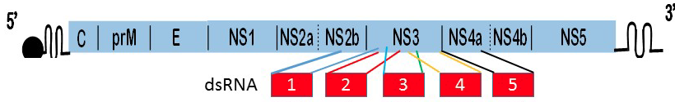
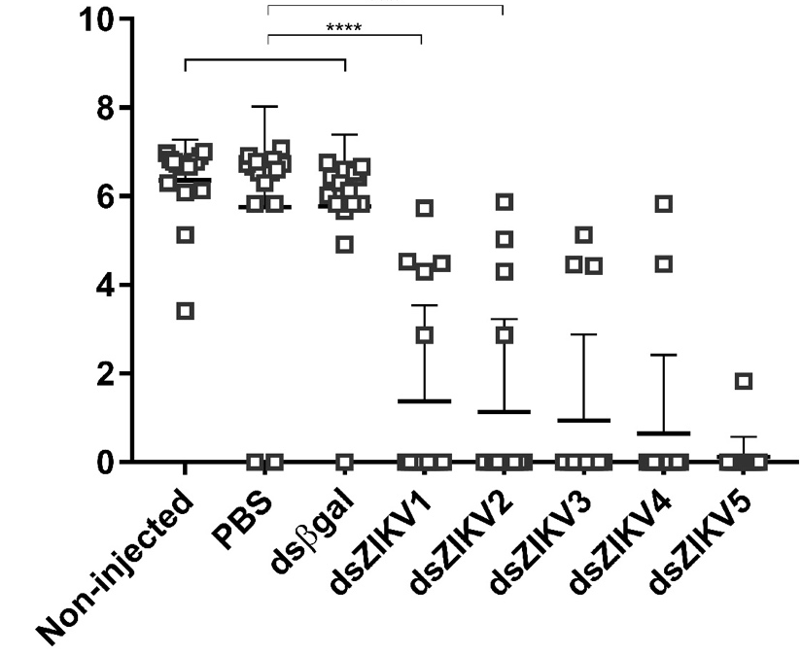
Determination of anti-ZIKV IR sequence
Conserved
~500bp
14dpi ZIKV PRVABC59
Whole mosquitoes
Log₁₀ PFU/mL
Magalhaes et al., 2019, Insect Biochemistry and Molecular Biology
Notes:
Nucleotide alignments of 21 ZIKV full-length genomes of isolates from Africa, Asia, and the Americas revealed that the average diversity among the viruses (C to NS5) was 13.9%. The level of diversity was lower than average for the NS2A-NS3-NS4A sequence. We transiently tested the more conserved ~2600 nt NS2B-NS3-NS4A sequence as an RNAi target because the exo-small interfering RNA (siRNA) pathway of RNAi is sequence dependent and targeting genome regions with a low level of sequence diversity among ZIKV isolates is necessary to ensure silencing of heterologous ZIKV genomes. We tested five ~500 bp dsRNAs derived from the NS2A-NS3-NS4A sequence in Ae. aegypti (Poza Rico strain) (Fig. 1). dsRNA production and virus challenge assay followed standard procedure (49). At 5 days post-emergence, 30 Poza Rica females were injected intrathoracically with 250 ng of dsRNA and two days later fed bloodmeals containing ~5x106 pfu/ml ZIKV. Viral titers in whole-body females were analyzed by plaque assay at 7 and 14 days postbloodmeal (pbm).
NS3 → protease & helicase. The protease domain + NS2B preforms viral polyprotein processing. The helicase domain assists in viral replication by unwinding dsRNA
NS4A → associated with virus replication complex (docking site?) and induces ER membrane rearrangements. After NS4A is cleaved, promotes membrane arrangements and induces curvature. Co-localizes with dsRNA
The objectives of this study were to assess the ability of the Ae. aegypti antiviral exogenous-small interfering RNA (exo-siRNA) response to inhibit ZIKV infection and transmission, and to identify the optimal RNA interference (RNAi) target region in the ZIKV genome.

Slide 10
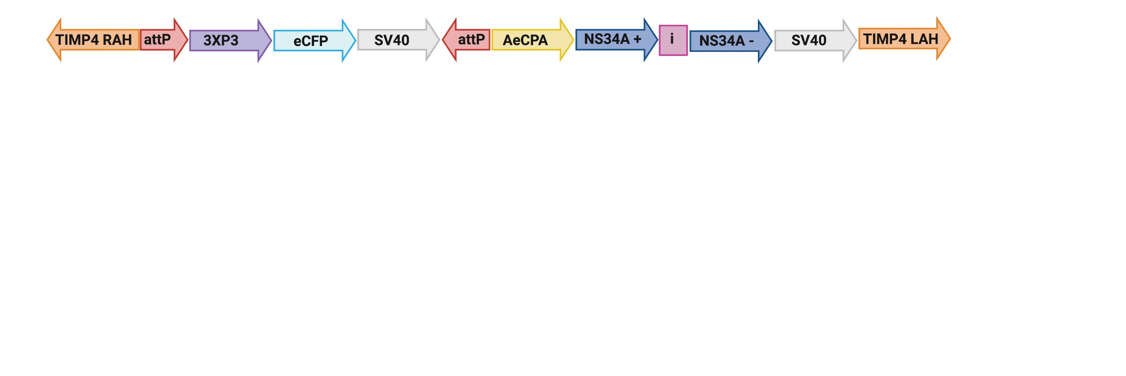
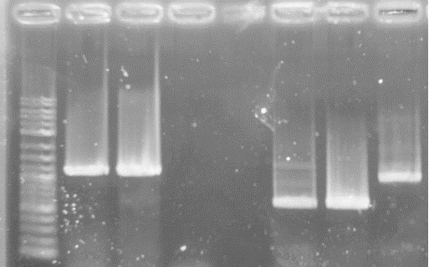
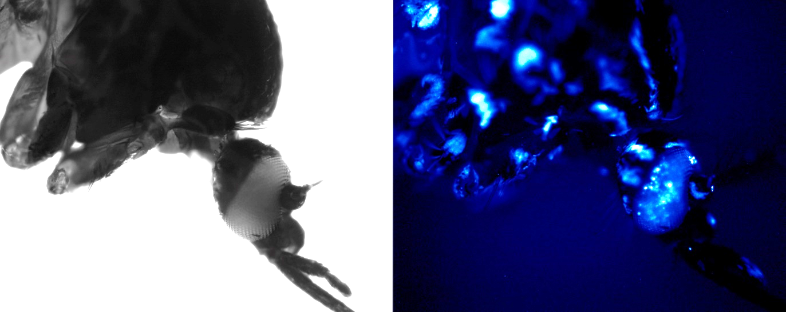
Anti-ZIKV NS3/4A transgenic construct
Using CRISPR/Cas9, construct knocked into Higgs White Eye (HWE) mosquitoes
i→TIMP4 LAH
AeCPA-→ i
1000
500
TG Φ HWE
TG. Φ. HWE
Confirmed by Sanger sequencing
Homozygous transgenic mosquitoes generated by Dr. William Reid, Mizzou

Slide 11
Anti-NS3/4A transgene is processed by siRNA machinery
Anti-NS3/4A siRNA length count
Anti-NS3/4A positional analysis

Slide 12
Anti-NS3/4A transgenic lines are resistant to ZIKV
Notes:
Stars indicate prevalences (chi square)
Those with disseminated infection have lower titer

Slide 13
Anti-NS3/4A transgenic lines are resistant to ZIKV
Notes:
Stars indicate prevalences (chi square)
Those with disseminated infection have lower titer

Slide 14
Anti-NS3/4A transgenic lines are resistant to ZIKV
Notes:
Stars indicate prevalences (chi square)
Those with disseminated infection have lower titer

Slide 15
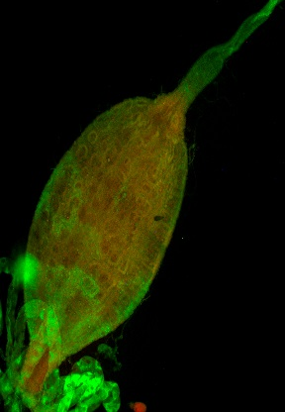
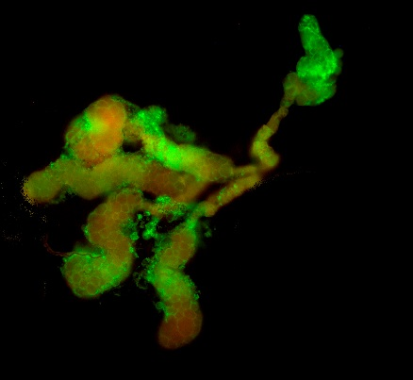
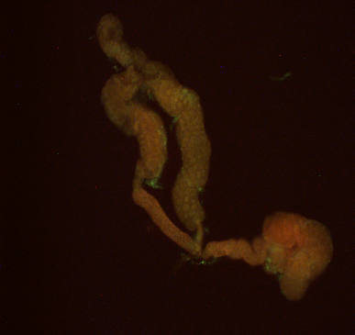
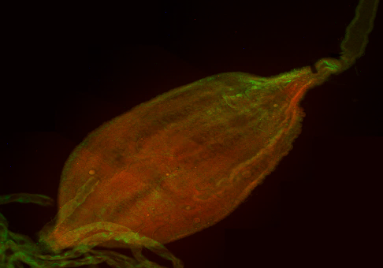
Anti-NS3/4A transgenic lines are resistant to ZIKV
HWE 14dpi PRVABC59
ZIKV
ZIKV
anti-ZIKV 14dpi PRVABC59
Notes:
Stars indicate prevalences (chi square)
Those with disseminated infection have lower titer

Slide 16
Anti-NS3/4A are resistant to ZIKV due to midgut infection barrier (MIB)
Franz et al., 2015
Notes:
Stars indicate prevalences (chi square)
Those with disseminated infection have lower titer

Slide 17
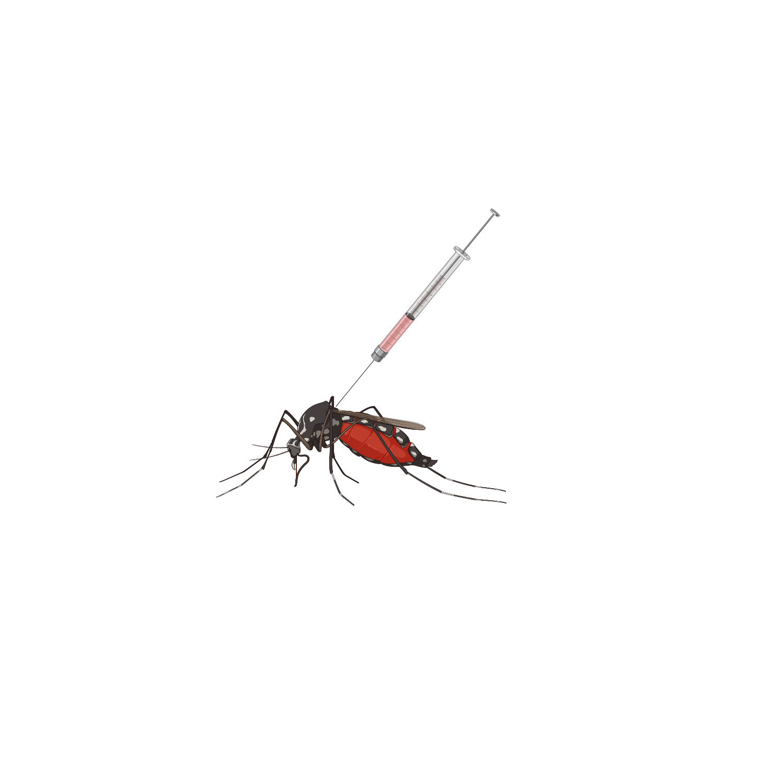
Anti-NS3/4A are resistant to ZIKV due to midgut infection barrier (MIB)
Franz et al., 2015
Notes:
Stars indicate prevalences (chi square)
Those with disseminated infection have lower titer

Slide 18
Anti-NS3/4A resistance is virus strain-specific
Notes:
Stars indicate prevalences (chi square)
Those with disseminated infection have lower titer

Slide 19
Conclusions
Successfully showed anti-ZIKV transgenics contain the IR gene, which is processed into siRNAs complementary to ZIKV genome
Transgenic cargo significantly inhibits ZIKV replication in vivo in a sequence-specific manner
We are testing multiple/different effector cargo at several genomic loci
We aim to couple the anti-pathogen effector cargo to a gene drive element for a population replacement vector control strategy
Future Directions

Slide 20
Acknowledgements
CSU
Ken Olson
Irma Sanchez-Vargas
Susi Bennett
Gabby Ramirez
Claudia Reuckert
Rebekah Kading
Tecca Magalhaes
Sequencing Core:
Mark Stenglein
Justin Lee
Marylee Layton
University of Missouri
Alexander Franz
Bill Reid
Roxy Juncu
Jingyi Lin
Notre Dame
Malcolm Fraser
Funding:
CSU MIP IDR2N
NIH GPP
NIH R01

